Slide 1
Overview results: Hydropower for the energy demand in Eefde Tonnie Tekelenburg 20-21/01/2020

Slide 2
Goals LochemEnergie
Contribution LochemEnergie to:
Sustainable development, climate policies,
By local production of renewable energy
Stronger local economy,
By reinvestment of local profit
Stronger social communities and quality of life,
By supporting local organisations
Decreasing expenses,
By lower energy bill

Slide 3
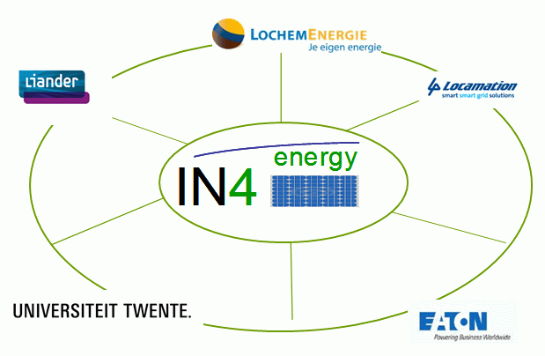
stages
High port Eefde (2011-2012)
Smart mix research (2013-2015)
Water storage research (2016)
Conclusion feasibility study LochemEnergie (2017-2018)
New technique and new company (end 2019)
Extra hurdles

Slide 4
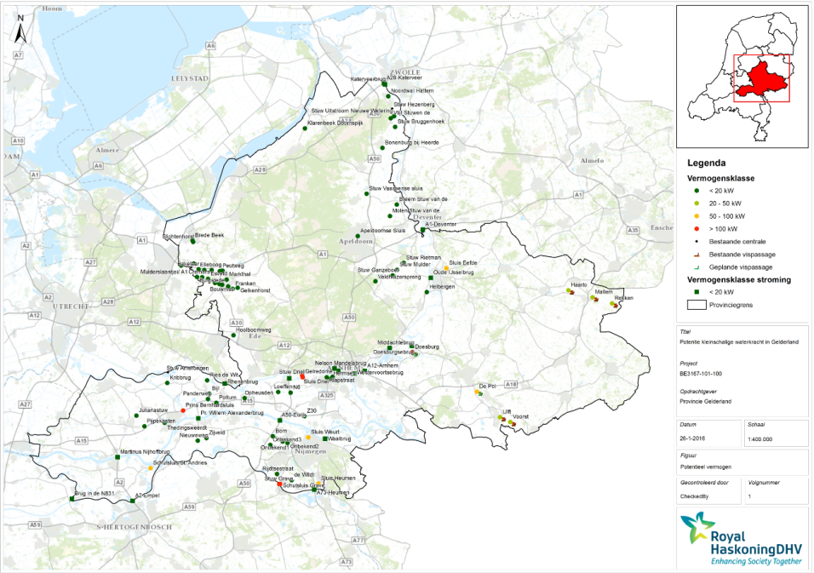

Slide 5
Weir Lochem

Slide 6
weir Berkel to IJssel

Slide 7
Onderslag/ undershot water wheel diameter 6m and a capacity of 11kW

Slide 8
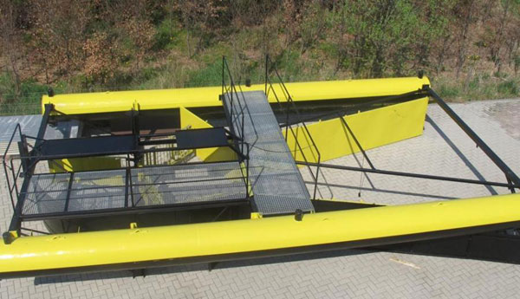
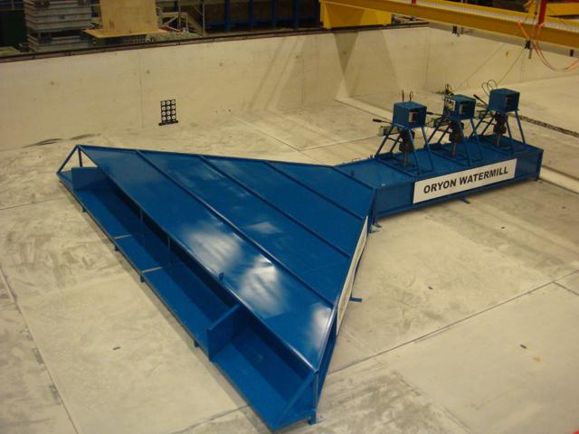
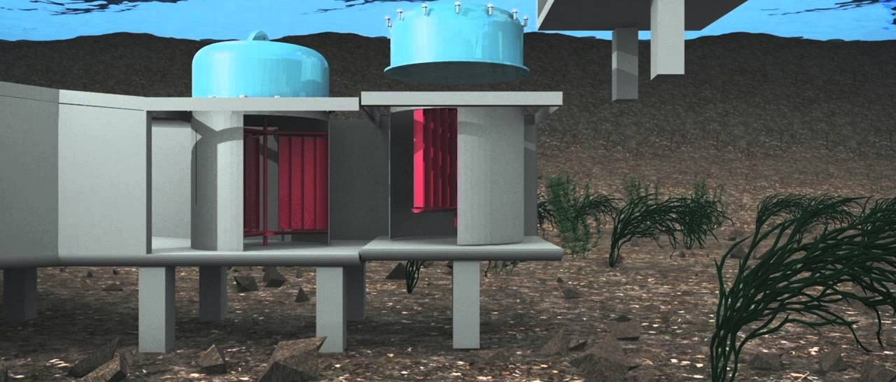

Slide 9
Whirlpool turbine with integrated fish ladder

Slide 10
whirlpool turbine

Slide 11
Own design

Slide 12
RWS impressie 2012

Slide 13
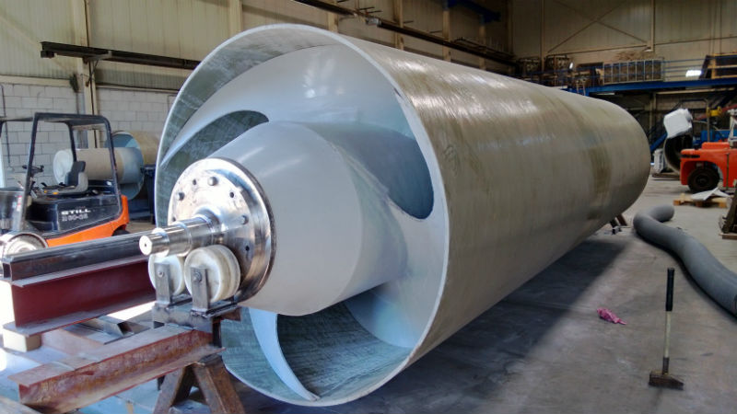
Vijzel/mooring turbine

Slide 14
Costs hydropower versus production capacity

Slide 15
Own calculation
sheets

Slide 16
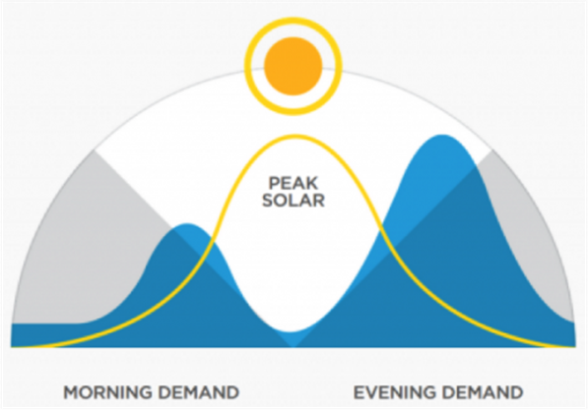
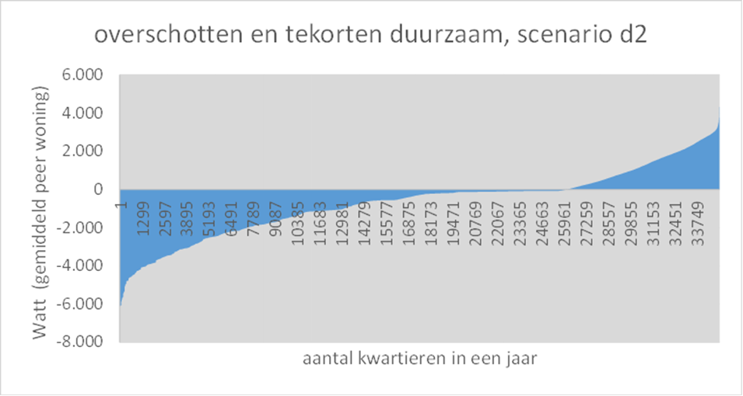
Analysis framework: mismatch per day and per year

Slide 17
Water storage feasibility study
Profitable business case from:
hydropower by combination of
two water streams and
water storage on the Twente channel

Slide 18
Hydropower scenarios
O = solar PV production
A = with hydropower from the Berkel river
B = with combined Berkel- en Twente channel- surplusses
C = and storage of watersurplussen on Twente Channel in raining season
D = and storage of surplussen on Twente Channel in dry period (pumping from river IJssel)

Slide 19
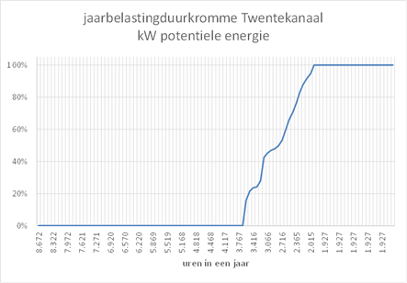
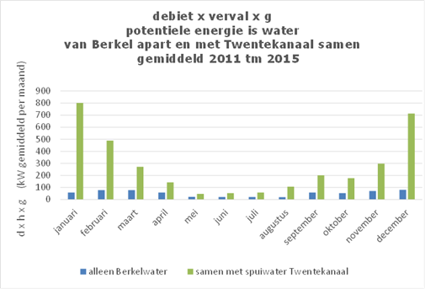
Potential from two water sources for hydropower

Slide 20
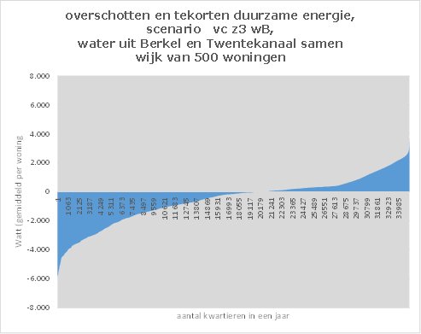
deficit/surplus solar-PV and with hydropower
solar-PV mix solar and hydropower two sources

Slide 21
Kanniewaarzijn conclusies
Geen bonus voor goed je best doen (grid balancering)
Geen spectaculair resultaat energieopslag
Geen toestemming RWS voor:
Gebruik bestaande pompen
Bouw WKC naar sluis
Energie opslag op Twente kanaal
Overtollig water afvoeren naar Berkel
Gebruik stuw op Berkel rivier?
Opstalrecht en watervergunning
Waterschap Visveiligheid: norm 2.7% vissterfte telt ook voor RWS?
Techniek: van vijzel naar bovenslag rad

Slide 22
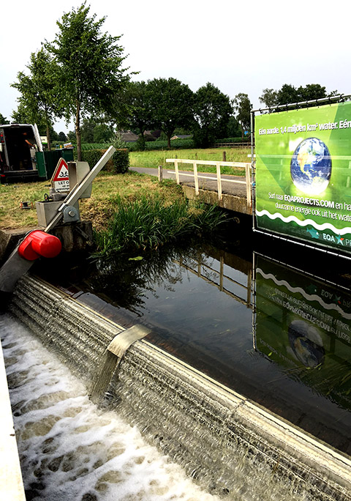
EQA box
Hangend aan de stuwklep
Verval 1.60 m
Totaal debiet 3000 l/s
2 x EQA Box 20
2 x 16 kW*
170.000 - 225.000 kWh/j**
€ 215.000 ***

