Slide 1


Community ENERGY COOPeratives
Grenville Ham and Gareth Ellis
The Green Valleys CIC
www.thegreenvalleys.org

Slide 2
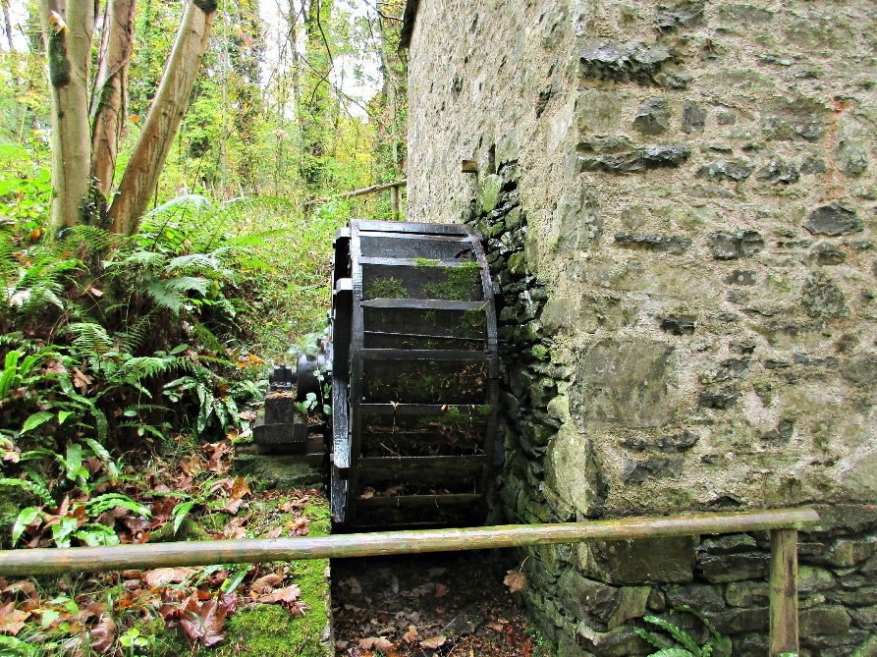
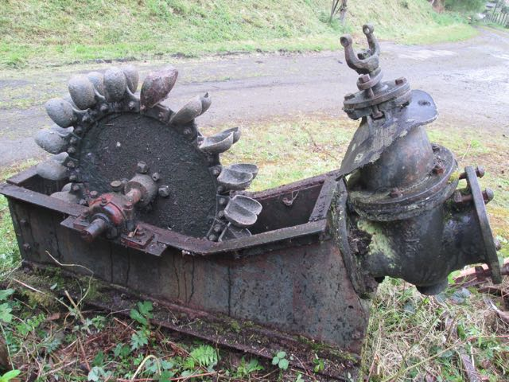
A bit of history
Common use of hydropower in mills as far back as medieval times for grinding corn, weaving and fodder.
Use of small hydroelectric power plant to supply communities and industry in early 1900’s

Slide 3
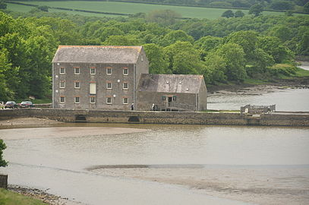
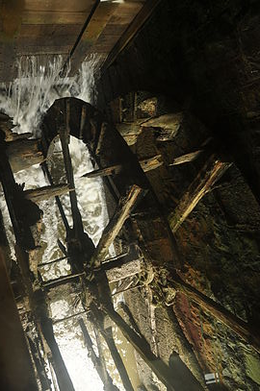
Carew Tidal Mill

Slide 4
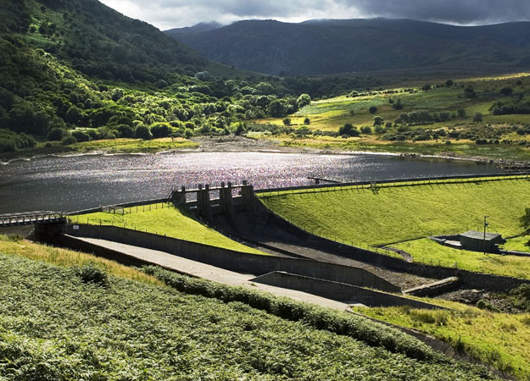
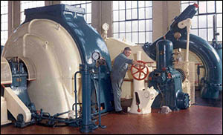
Big engineering

Slide 5
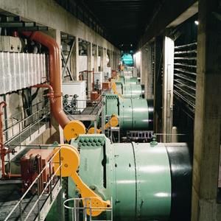
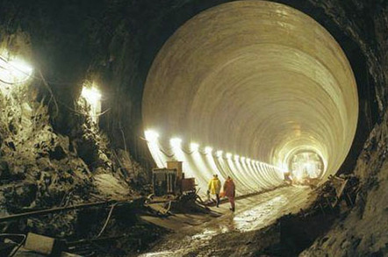
Very big engineering

Slide 6
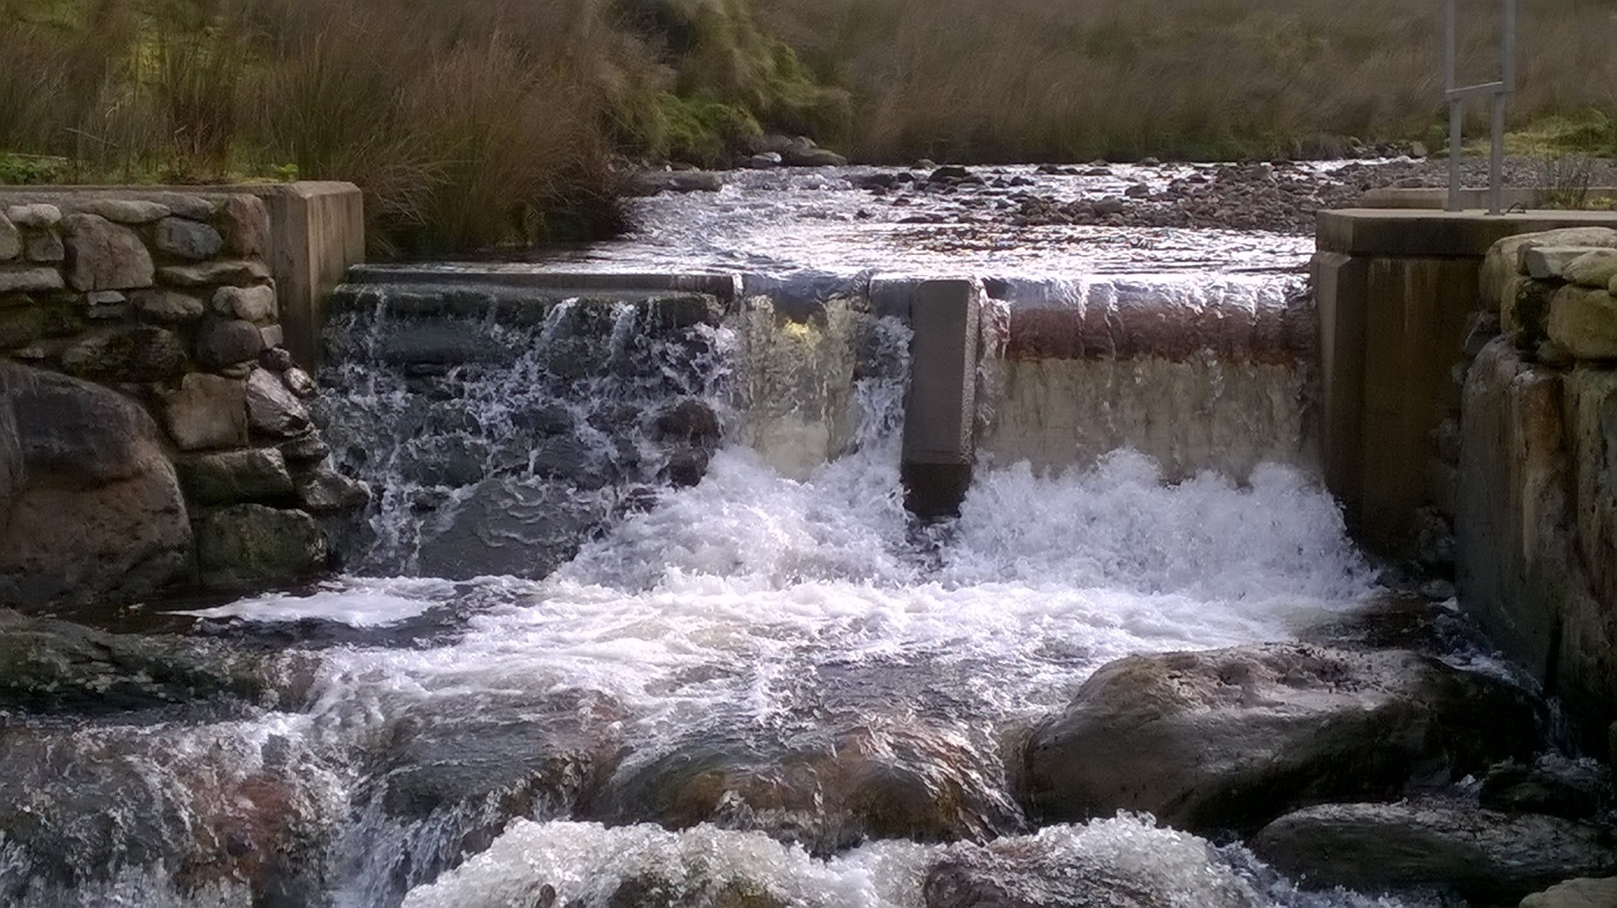
Post 2010 – sub 100kW, high head, run-of-river schemes

Slide 7
The Green Valleys CIC
  Established in 2009
  Not for Profit Community Interest Company
  Designed and Built over 70 Hydropower schemes
  Established Hydropower Turbine Manufacturer
  17 Woodland Groups
  Dozens of Community Groups Supported
  Food growing Initiatives
  Woodfuel / Charcoal enterprises
  Local Apple Juice and Cider Business
  Energy Local Model (Buying and Selling Electricity Locally)
  Advice and energy efficiency

Slide 8
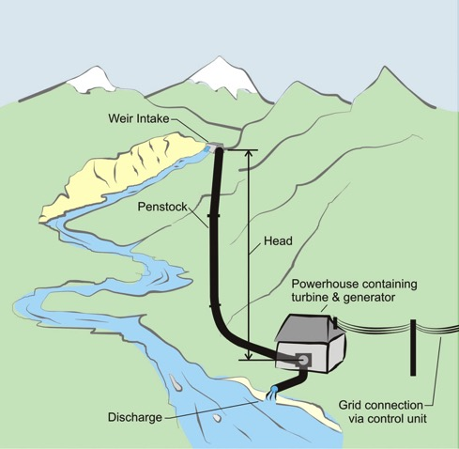
Hydro – High Head
Notes:
1kW = 2 homes, Domestic energy

Slide 9
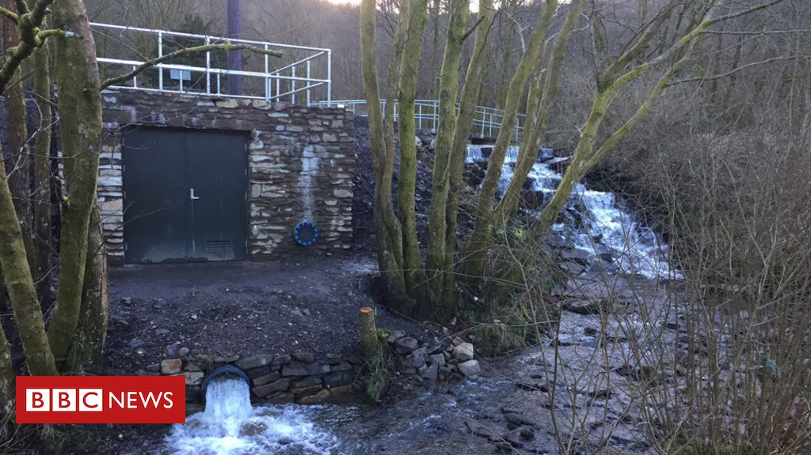

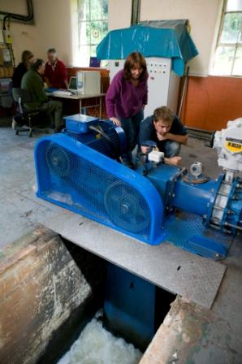
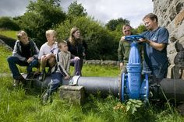
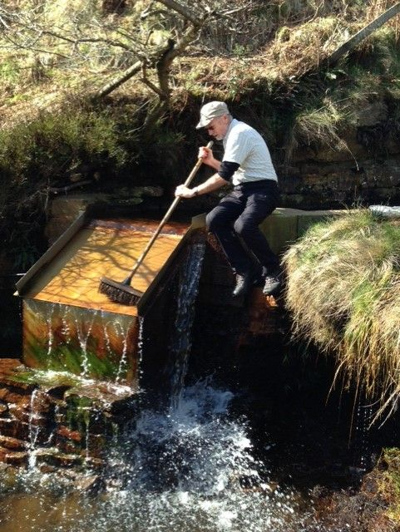
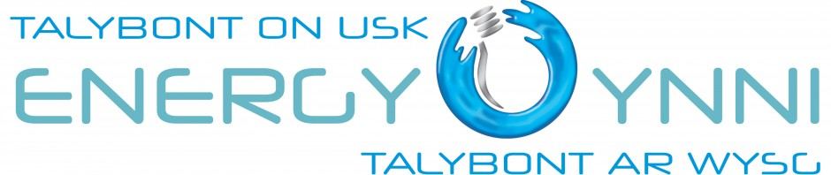
HydroPower

Slide 10
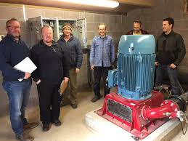
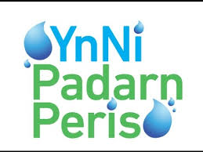
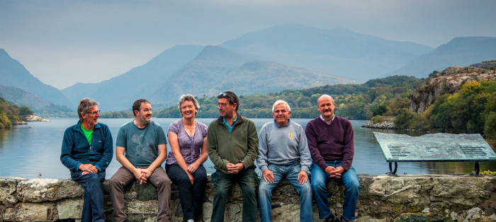
HYDROPOWER

Slide 11
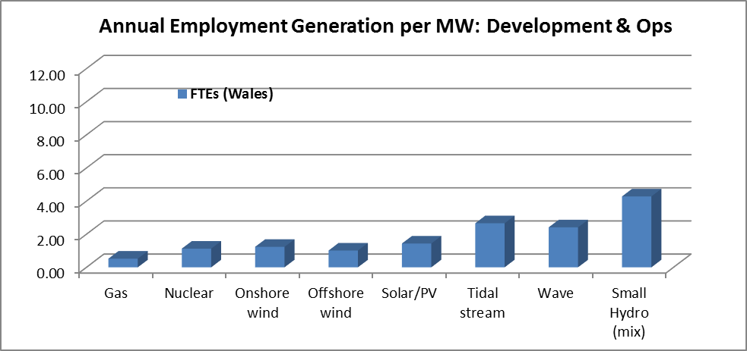
Cardiff UnI research – Small Hydro

Slide 12
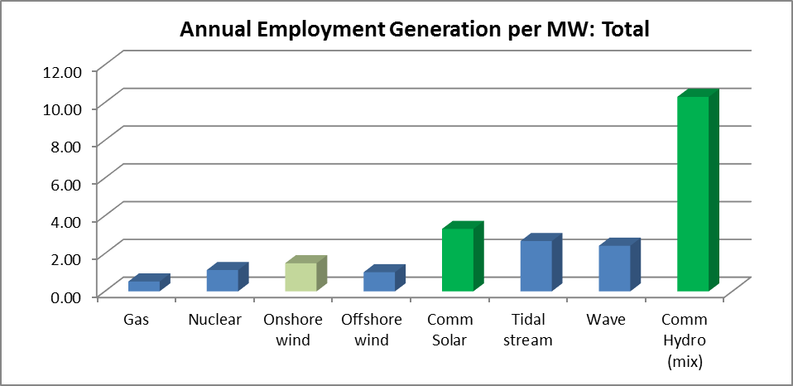
Cardiff UnI research – ComMUNITY Hydro

Slide 13
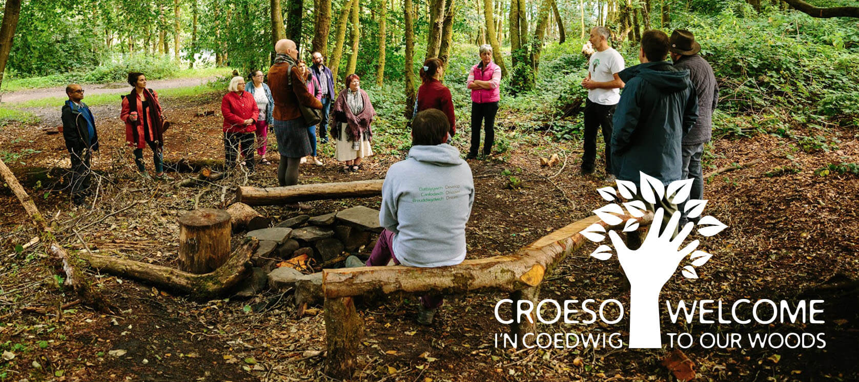
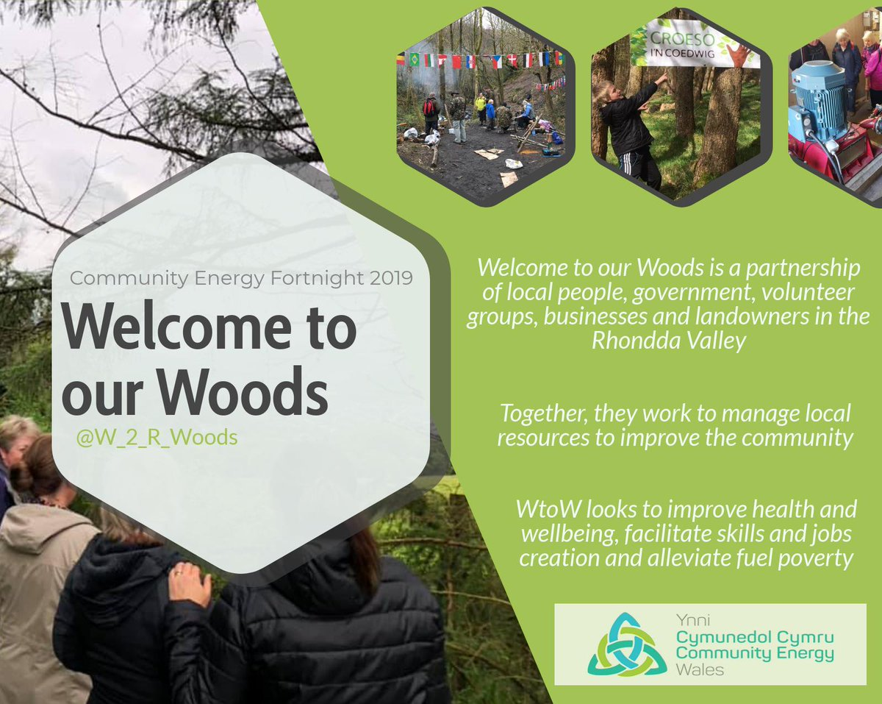
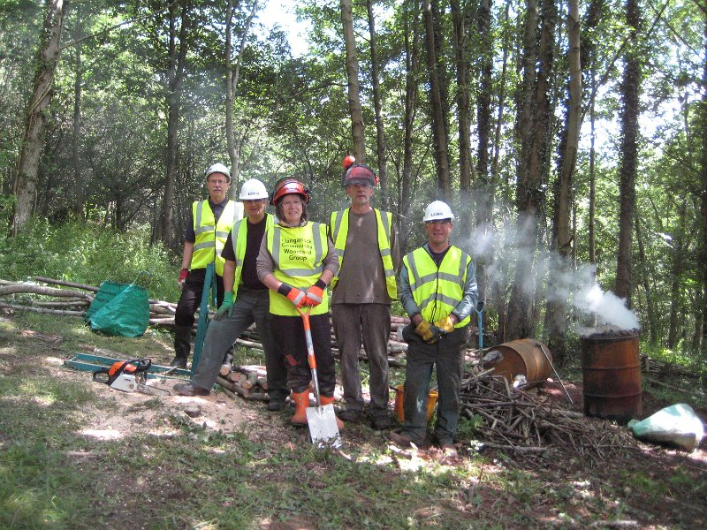
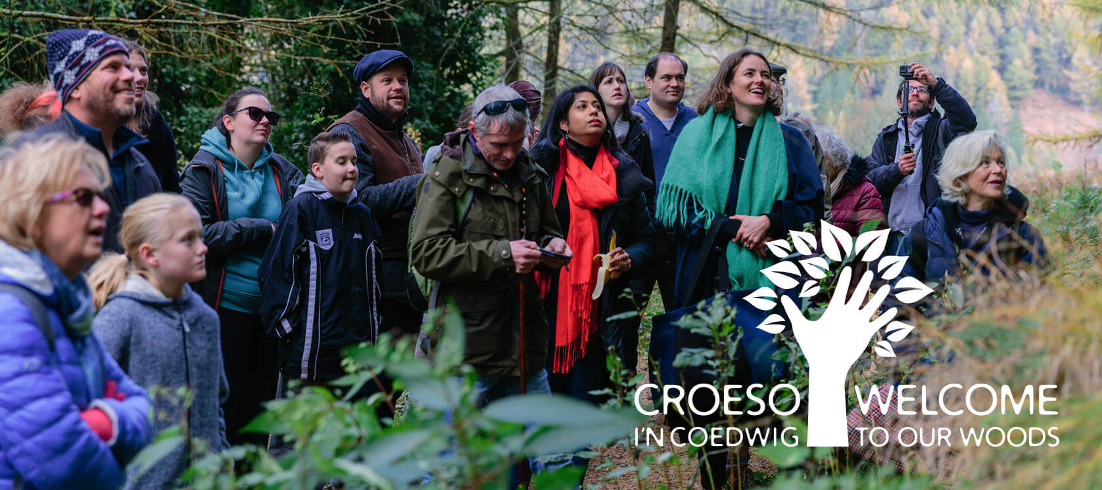
Woodlands

Slide 14
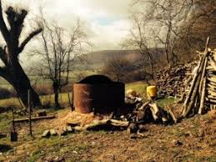

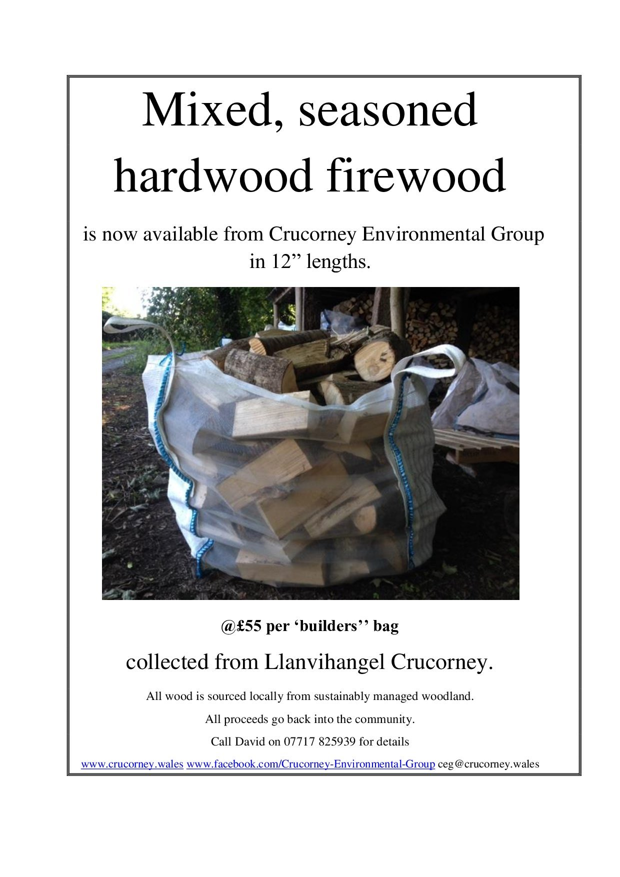
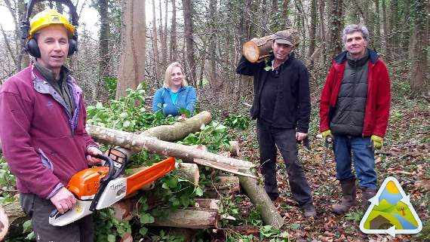
Woodland Products

Slide 15
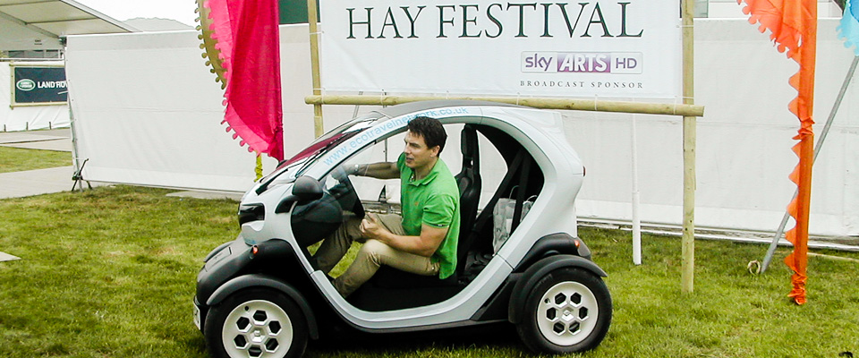
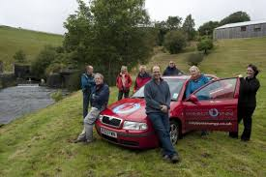
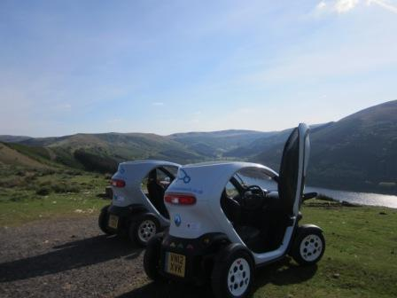
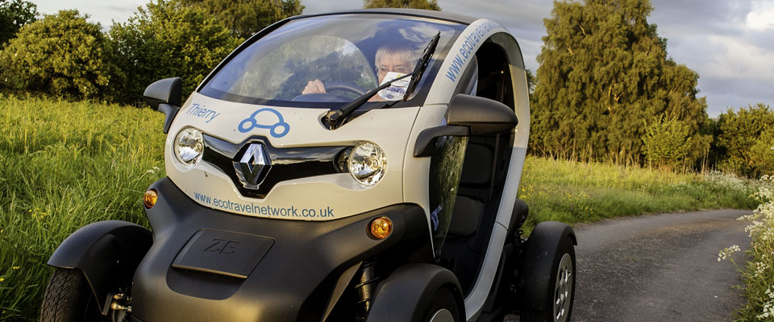
Community Owned ELECTRIC CARS

Slide 16

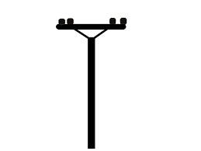
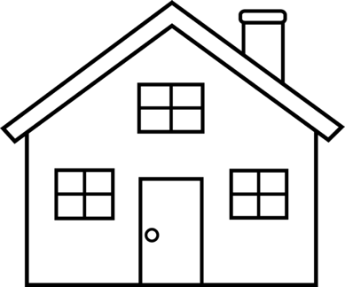
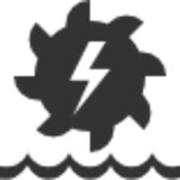
Establishing a LOCAL ENERGY MARKET

Slide 17
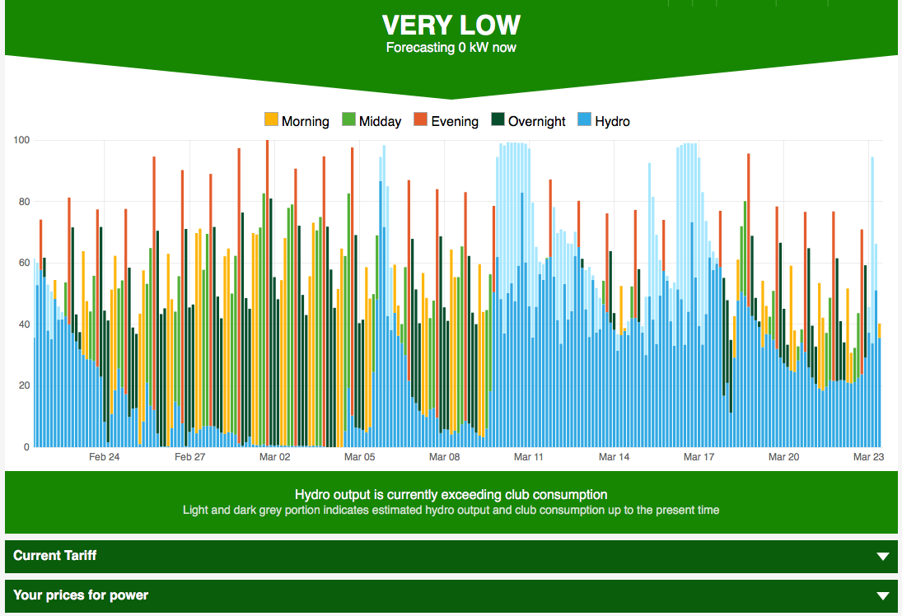
DEVELOPING The LOCAL MARKET
.

Slide 18
Licences, consents and approvals for hydropower
Abstraction licence (Water Resources Act)
Impoundment licence (Water Resources Act)
Flood Risk Activity Permit (FRAP) (/Env Permitting Regs)
Ordinary Watercourse Consent (OWC) (LLFA)
Fish pass approval
Consent for working in a protected site (SACs/SSSIs)
Protected species licensing
Felling licence
Flood Consequences Assessment (T&C Planning)

Slide 19
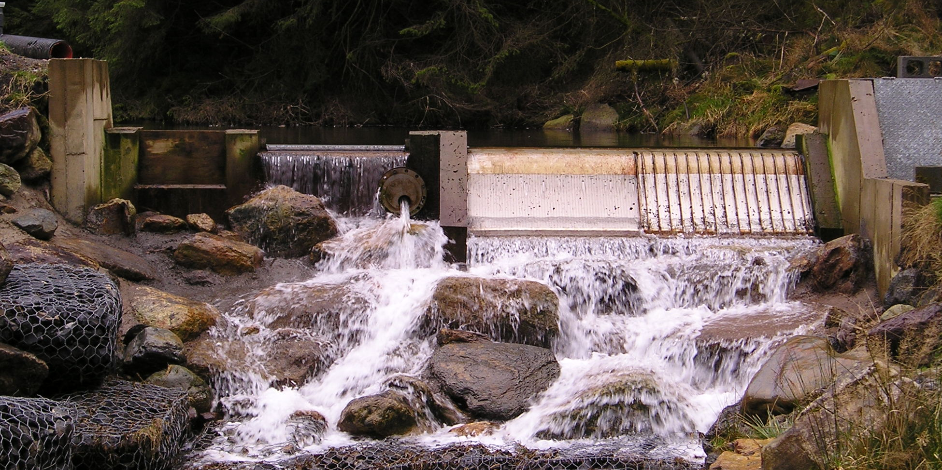
Low impact abstraction regime
NRW Guidance - introducing the flow split
Zoning – 10%, 40%, 50% and 70% take
Maintains flow variability in the low/medium flow range
Important for ecology and geomorphological processes

Slide 20
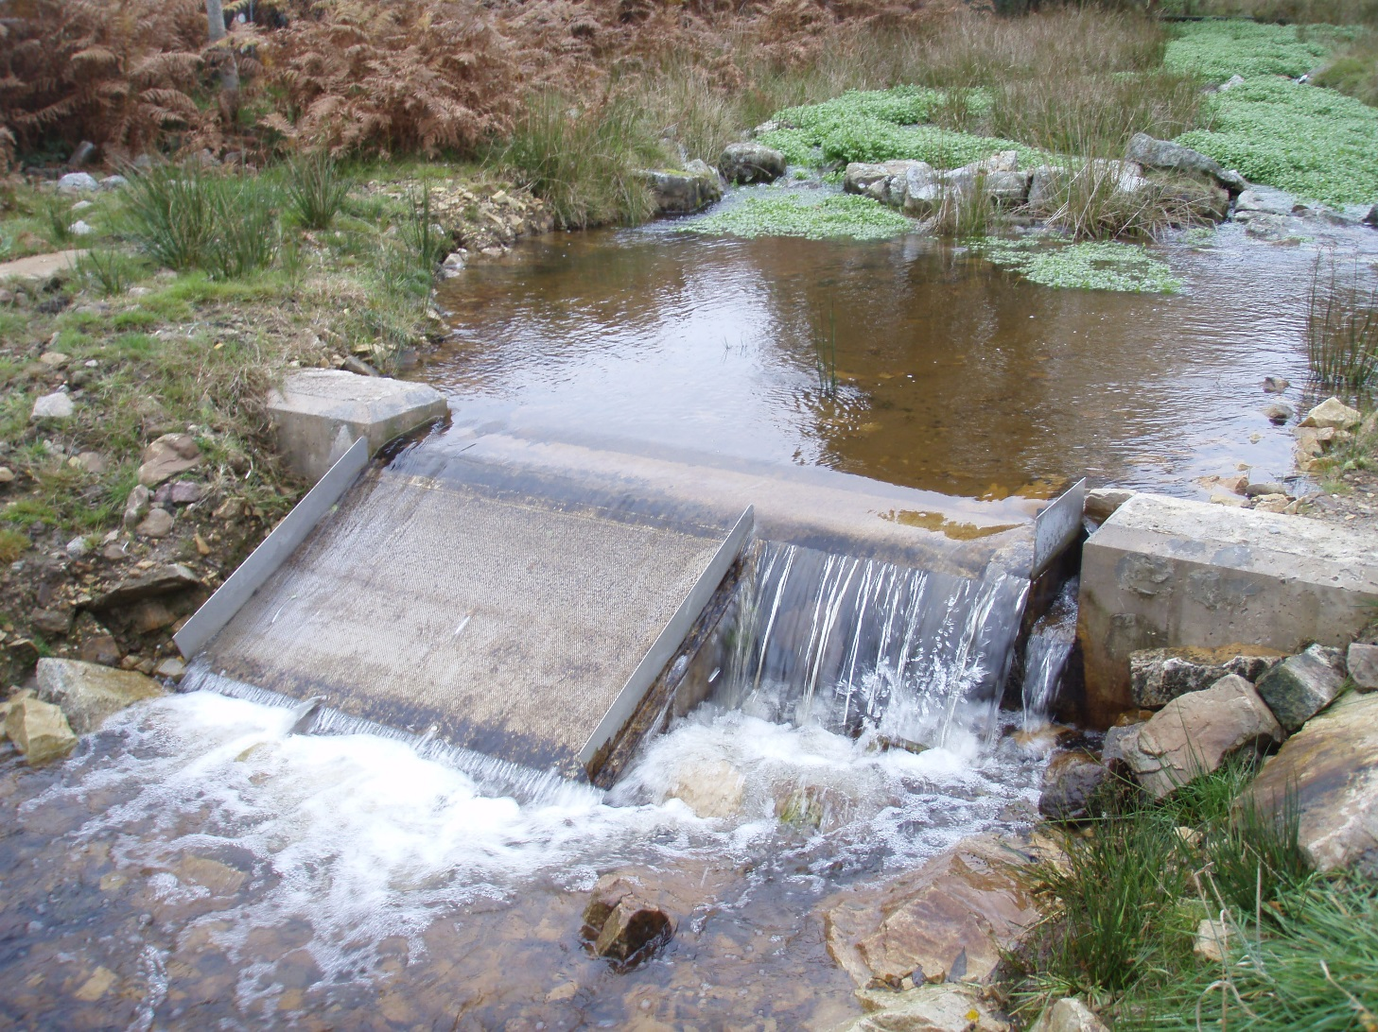
Design components - passive hydraulic control
Abstraction flow
Residual flow (% take)
Low flow notch

Slide 21
Disruption to ecosystem connectivity and geomorphological processes

Slide 22
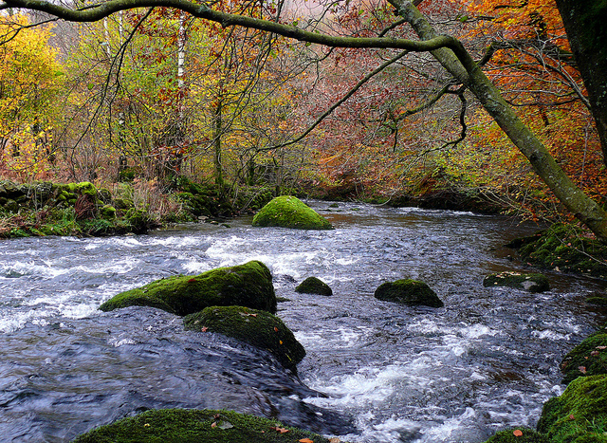
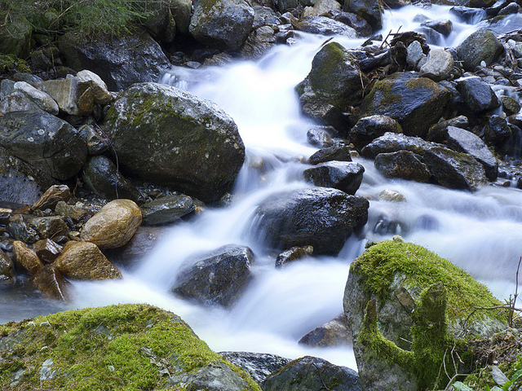
Management Zones 2 & 3
Based on simple geomorphological classification
Zone 2
<10% gradient
Zone 3
>10% gradient

Slide 24
Low impact siting and design principles
Consider geomorphological setting of any structure location – ‘siting’
Work with nature - replicate / mimic natural features
Site within confined channel / valley
Steep bed gradient
Select stable bed and bank material
Select straight river reaches
Avoid active river reaches
Place at or below break of channel slope
Locate downstream of nearby inflows/tributary

Slide 25
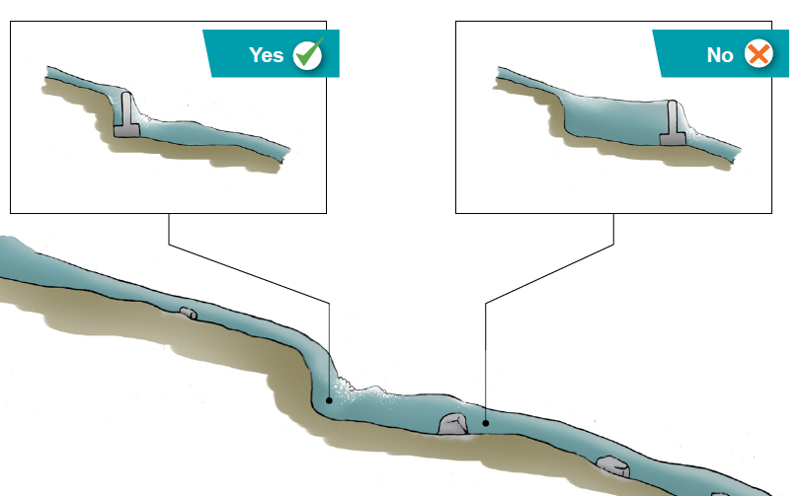
Site intakes at natural steps
Every site is different and must be considered individually

Slide 26
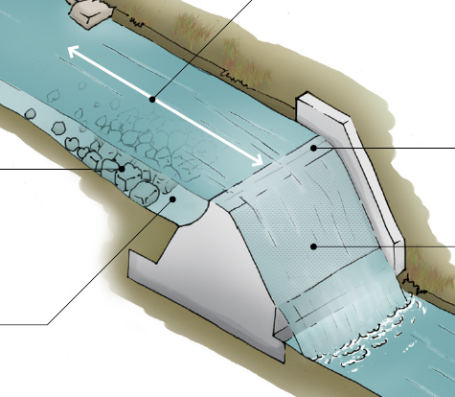
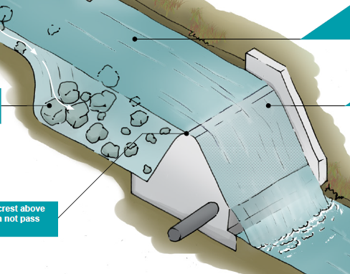
Minimise impact on sediment transport

Slide 27
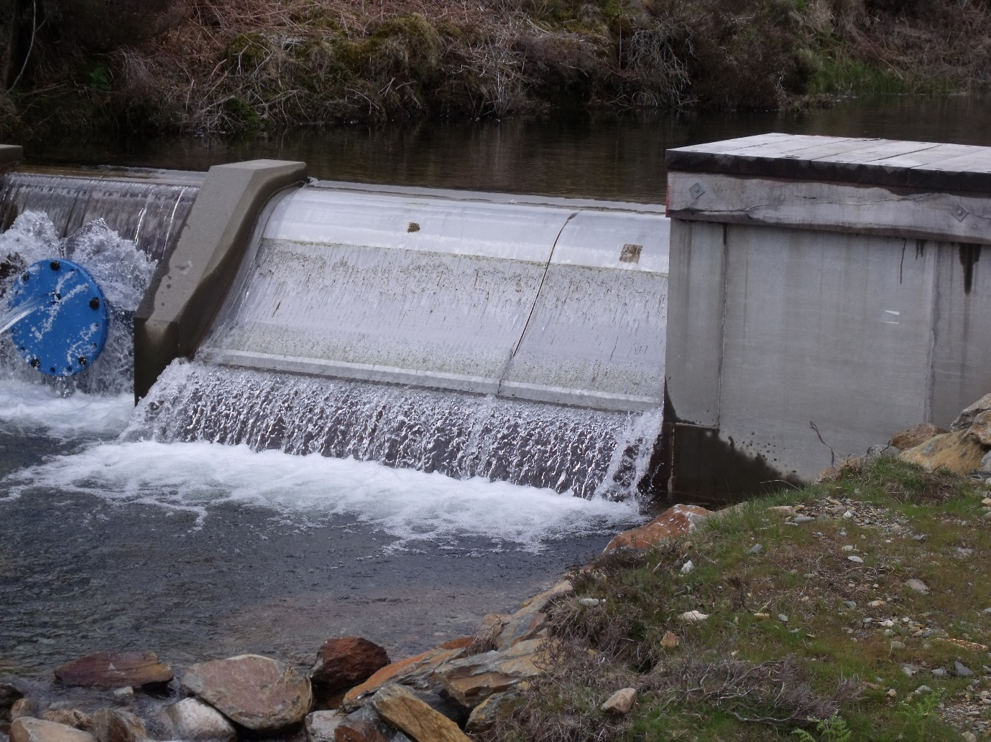
Screening (High Head/Zone 3)
Screening for high head, run-of-river hydropower
Majority of intakes use 1 to 2 mm Coanda screen or perforated plate.
Plunge pool is required downstream

Slide 28
Screening (Low Head/Zone 2)
More complex depending on species and life stage present
Majority of Zone 2 sites will support juvenile salmonids and be on a migration route
Screening down to 6 or 10 mm
Approach velocities
Bywash (safe downstream route)

Slide 29
Fish passage
Migratory species – Atlantic salmon, sea trout (Sewin) and eel
BUT all species migrate to complete their lifecycles
HEP intakes can present barriers to fish migration and so lead to habitat fragmentation
Salmon and Freshwater Fisheries Act (1975)
The Eels (England and Wales) Regulations 2009
Water Framework Directive
Environment (Wales) Act 2016

Slide 30
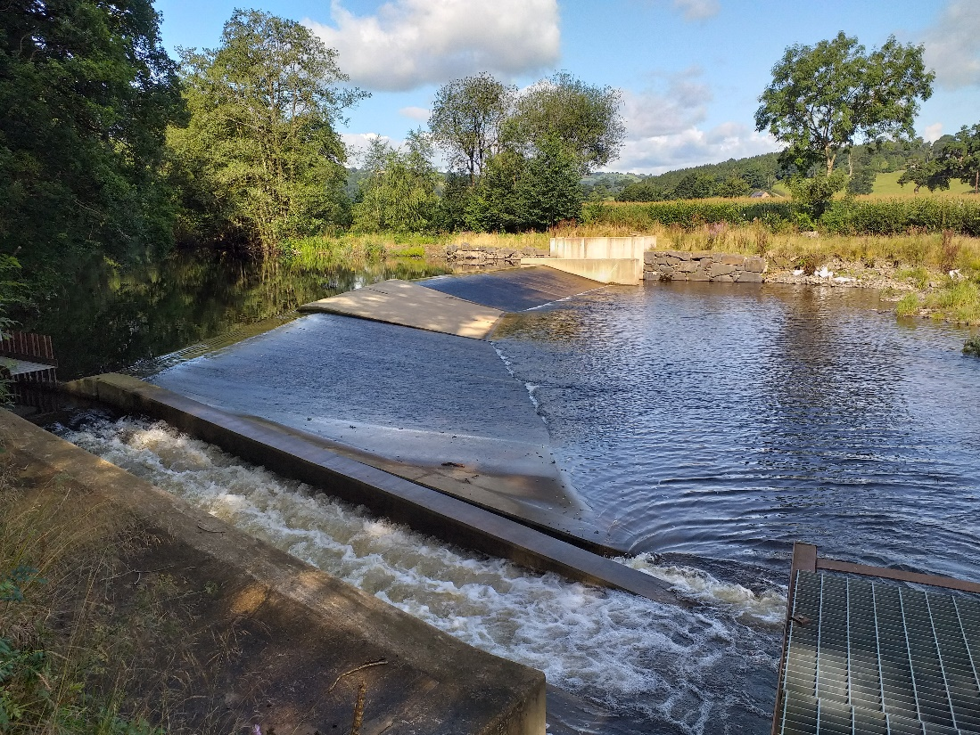
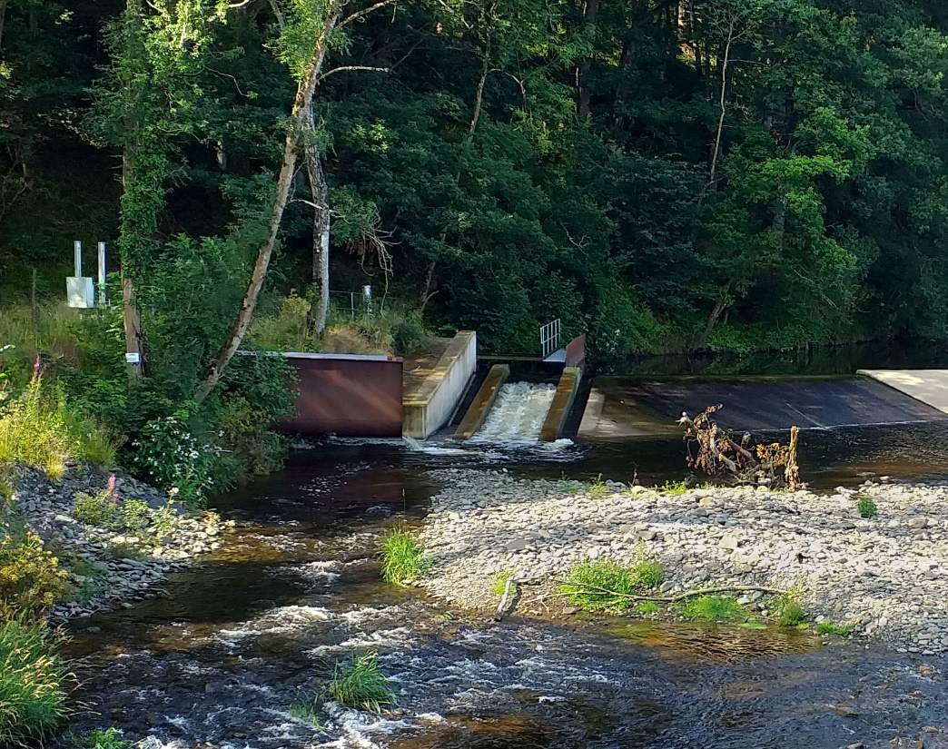
Fish passage
Migratory salmonids
Technical fish pass – requires Formal Fish Pass Approval from NRW (SAFFA)
Detailed engineering design – included in permits

Slide 31
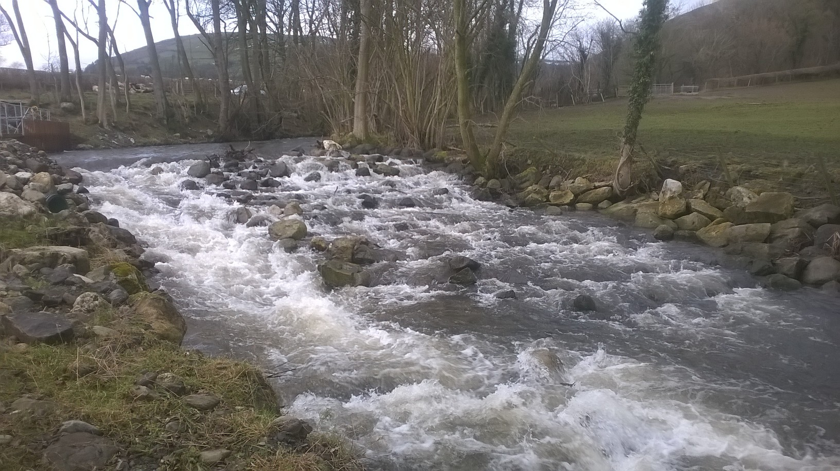
Fish passage
Migratory salmonids – existing weir

Slide 32
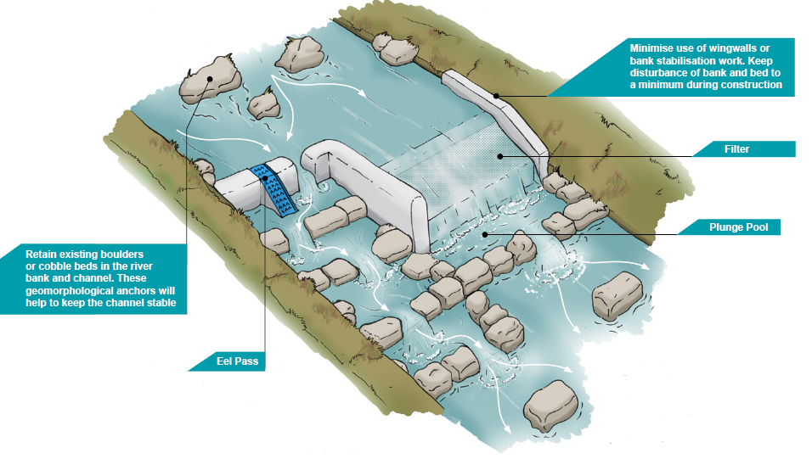
Generic design

Slide 33
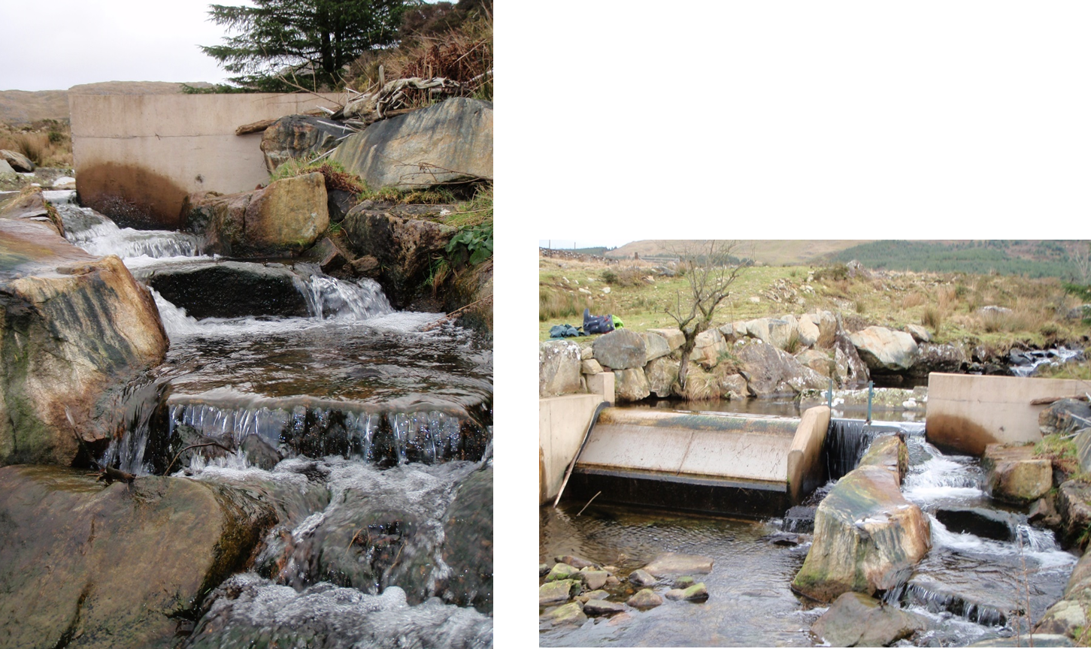
Fish passage
Fish passage easement for resident brown trout
Fish passage easement

Slide 34
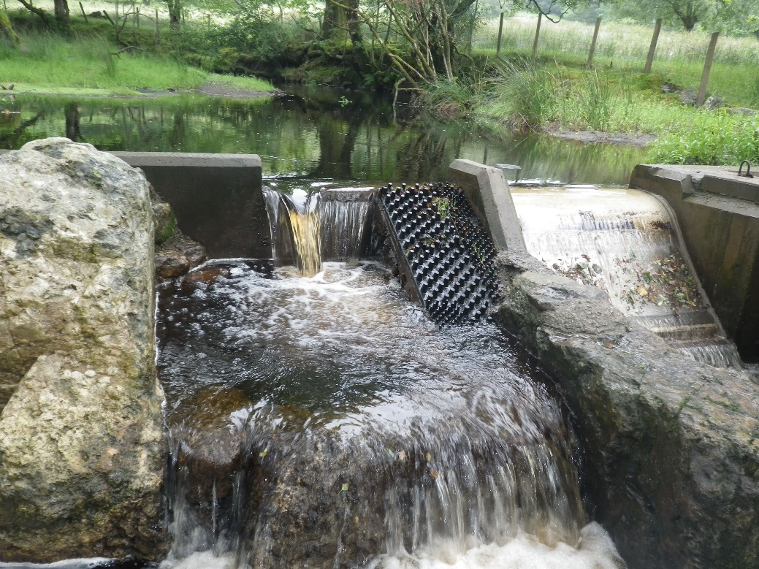
Eel passage – boss type

Slide 35
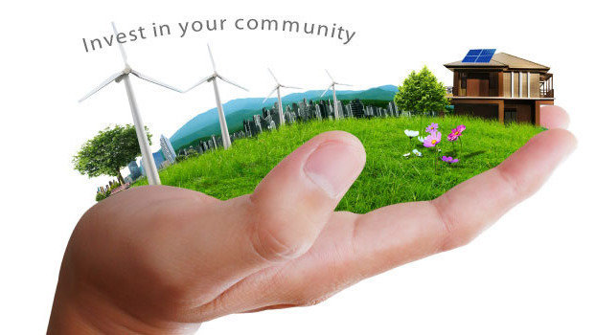
ANY QUESTIONS?

